Slide 1
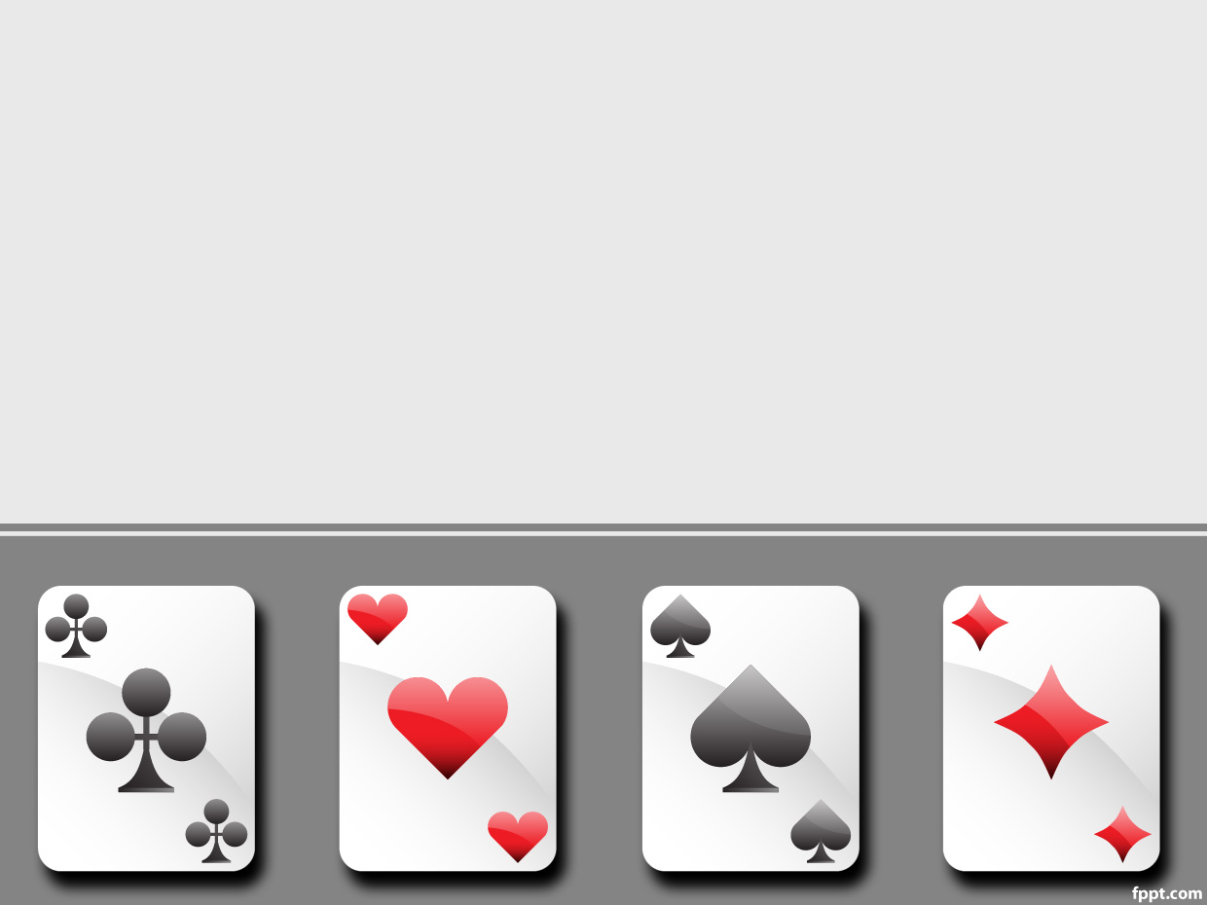
OpenCV for Python
Image Recognition and Card Detection
Hasan Haq

Slide 2
What is OpenCV?
Open Source Computer Vision
Created by Intel R&D in Russia (1999)
Written in C++
Ported to Python, Java, MATLAB, C#, Perl, Ruby, and more
Current stable release: 3.2

Slide 3
What Does OpenCV Do?
Image processing (pixel level)
Feature detection and matching
Object detection (cascade classifiers)
Video analysis
Support Vector Machines (SVM)
And more!

Slide 4
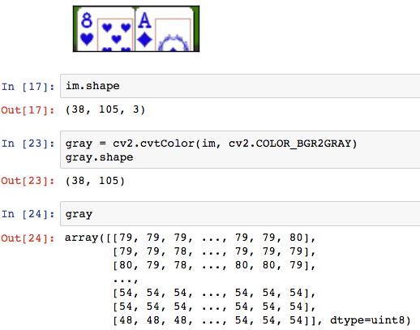
What’s in an image?
Numpy array with shape x, y (pixels)
Value corresponding to pixel intensity or RGB scale

Slide 5
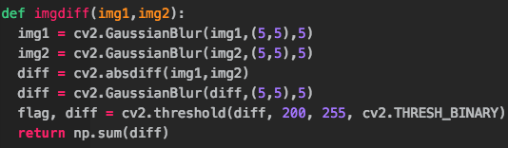
Thanks, Arnab!
Not quite…
absdiff() “algorithm”
Very simple script
Used blurring techniques
Perfecto!
Source: http://arnab.org/blog/so-i-suck-24-automating-card-games-using-opencv-and-python

Slide 6

Test Set…

Slide 7
Training Set…

Slide 8
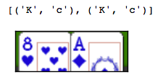
Huh??
Imgdiff() Calculation
Result

Slide 9
Try Again…

Slide 10
Feature Matching
SIFT, SURF, ORB
Scale and rotation invariant

Slide 11
Feature Matching
Distances
Thresholds
# of pyramid levels
# of matches

Slide 12
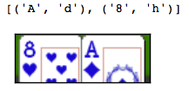
Success! (Kinda)

Slide 13
Object Detection
Haar Cascade Classifiers
Requires large (?) training sample
Not scale/rotation invariant

Slide 14
Poker Applications
Almost there!

Slide 15
Questions?

